Slide 1
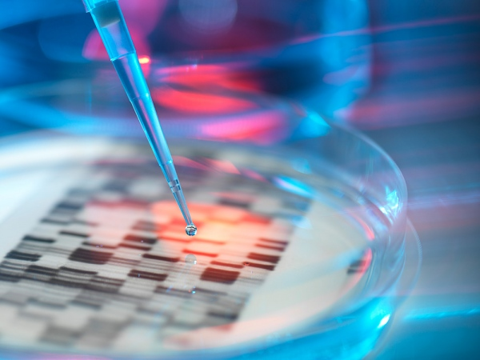
BCM II
Andreia Santos
Armanda Rebelo
Bárbara Rodrigues
Raquel Ricardo
- Turma 10
Neurodegenerative diseases and triplet expansion

Slide 2
Triplet Expansion
Dynamic mutation
Repetition of three nucleotides in a particular gene.
Normal individuals
Reduced number of sequentially repeated triplets
Notes:
A triplet expansion is a dynamic mutation. It is a process in which there is a repetition of three nucleotides in a particular gene.
A normal individual carries a reduced number of sequentially repeated triplets.

Slide 3
Number of repetitions exceeds a critical threshold
Pathogenic
Critical Threshold
Number of repetitions above which there is a manifestation of the disease
Notes:
But, when the number of repetitions exceeds a critical threshold, meaning the specific number above which there is a manifestation of the disease, the mutation becomes pathogenic. In fact, increased numbers of repeated triplets are associated with several genetic diseases.

Slide 4
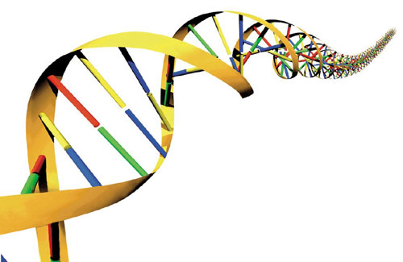
Causes
Slippage in DNA replication
Crossing over
Failure of DNA repair mechanisms
Notes:
The slippage in DNA replication and crossing over are two possible sources for triplet expansion. Also, these mutations remain because the DNA repair mechanisms fail.

Slide 5
http://www.youtube.com/watch?v=jH_LfHHpW2Q
Notes:
1 – This DNA molecule has got eight copies of the repetition CAG.
2 – The two strands separate from each other…
3 – And then they replicate.
4 – During the replication, a ‘loop-out’ structure is formed in the new strand..
5 – Which will lead to a repeated replication of part of the original strand and to the increase in the number of repetitions in the newly synthesized strand.
6 – The two strands of the new molecule separate…
7 – And the strand which contains a bigger number of CAG repeats is the one that is going to be used in the new replication.
8 – The resulting DNA molecule contains five additional copies of the CAG repeat.

Slide 6
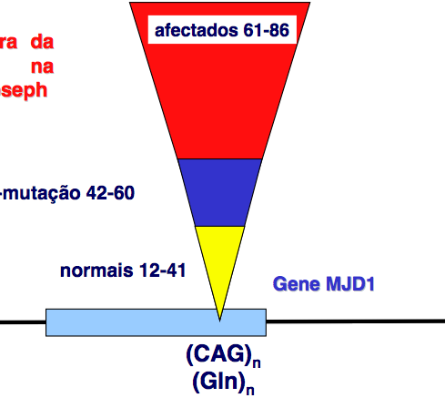
Premutation
Affected 61-86
Premutation 42-60
Intermediate stage between normal and mutation where the number of repetitions is beyond the normal limit, but still below the critical threshold
Normal 12-41
Notes:
In the first case, a normal individual can have between 12 and 41 repeated triplets. For the disease to express, the person must have over 60 repetitions. In other cases, people may have between 42 and 60 repetitions, being in a stage that is called premutation. (normally, this individuals don’t have any symptoms). However, the number of repetitions in this case is very close to the critical threshold which means that the next generation will have a higher probability to develop the disease, due to the phenomenon of anticipation.

Slide 7
Anticipation
Severity of the disease increases with each generation
Symptoms start to appear at an earlier age
Notes:
Anticipation is a phenomenon in which the severity of the disease increases with each generation and the symptoms start to appear at an early age. The severity of the disease and the age when the first symptoms appear depend on the number of the repeated trinucleotides.

Slide 8
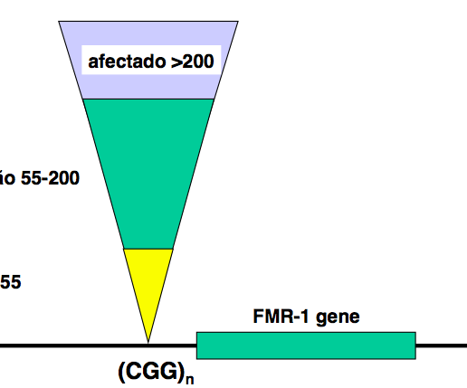
Affected >200
Affected 42-40
Normal 12-41
Notes:
Here, we can see that in the expansion of different triplets, the critical threshold is a different value. Besides, the triplet expansion may occur in the coding region of a gene or in its neighborhood.

Slide 9
Triplet expansion
Loss of function
Gain of toxic function
Notes:
This type of mutation may lead to a loss of function by the proteins or, in the other hand, they may gain a toxic function.
Repetitions associated with loss of function are typically much longer than those that correspond to a gain of function by the mutated protein, which becomes toxic.

Slide 10
 |  | Number of Trinucleotide Repeats
Disease | Repeated Sequence | Normal | Disease
Kennedy’s Disease | CAG | 11-33 | 40-62
Fragile X Syndrome | CGG | 6-54 | 50-1500
Jacobsen Syndrome | CGG | 11 | 100-1000
Spinocerebellar Ataxia | CAG | 4-44 | 21-130
Autosomal Dominant Cerebellar Ataxia | CAG | 7-19 | 37- ~220
Myotonic Dystrophy | CTG | 5-37 | 44-3000
Huntington’s Disease | CAG | 9-37 | 37-121
Friedreich's Ataxia | GAA | 6-29 | 200-900
Dentatorubral-pallidoluysian Atrophy | CAG | 7-25 | 49-75
Notes:
The repetition of different triplets leads to different pathologies. For example, Huntington’s Disease is caused by the expansion of the CAG triplet while Fragile X Syndrome is due to the expansion of CGG.

Slide 11
PolyGlutamines
Neurodegenerative diseases
Expansion of CAG
Coding region of the gene
PolyQ tract
Proteins with glutamine
Notes:
Several neurodegenerative diseases are caused by an expansion of the CAG triplet, that encodes glutamine.
Once this triplet is found in the coding region of the gene in question, the expansion of the CAG triplet leads to the production of proteins with an increased number of glutamines (polyglutamine tract).

Slide 12
Neurodegenerative diseases
Neurodegeneration is the progressive loss of neuronal structure or function, leading to the death of neurons;
Neurodegenerative diseases differ from each other in the affected gene.

Slide 13
Characteristics
An insidious onset and chronic progression;
Anatomically, some parts of the brain, spinal cord or peripheral nerves fail and the neurons in that region start to die.
Notes:
An insidious onset and chronic progression -which means they develop gradually and the patient does not have any symptoms until the disease is established.

Slide 14
But, why does the increase of glutamine in proteins lead to neurodegenerative diseases? Why does it lead to the death of neuronal cells?
Notes:
The triplet expansion leads to an increase in the number of glutamines which that gene encodes resulting in a bigger protein. These proteins will aggregate. In fact, several neurodegenerative diseases are associated with the aggregation of misfolded proteins inside the cells. Because these proteins become toxic, the neurons will be affected and will eventually die, once these proteins with a high number of glutamines, don’t acquire their correct conformation. Depending on the place inside the cell where these proteins aggregate, for example in the nucleus or in the cytosol, different diseases may appear.

Slide 15
Picture 1 – Intranuclear aggregates in HD

Slide 16
Huntington’s Disease
Dominant inherited neurodegenerative disease
Caused by:
Expansion of CAG triplet
coding region of the IT-15 gene
huntingtin (Htt)
chromosome 4
Notes:
Huntington's disease (HD) is a dominant inherited neurodegenerative disorder caused by an unstable expansion of a CAG repeat within the coding region of the IT-15 gene located on chromosome 4.
This mutation in the gene that encodes a protein called huntingtin (Htt) produces an altered form of this protein.

Slide 17
Notes:
In a healthy individual’s gene, this sequence is typically about 20 replicates. On the other hand, in DH gene the sequence has more than 35 repetitions.

Slide 18
Huntington’s Disease
Alterated huntingtin
Dysfunction
Gain of toxic function
Death of nerve cells
Notes:
The altered htt, produced due to the expansion, causes dysfunction due to a gain of toxic function and death of nerve cells (neurons) in certain regions of the brain.

Slide 19
Huntingtin Protein - Functions
In adult neurons and cell viability;
In the balance of iron homeostasis;
In the regulation of transcription;
In traffic, endocytosis and intracellular signaling.
Notes:
The huntingtin protein performs several functions in humans:
- In adult neurons and cell viability;
- In the balance of iron homeostasis;
- In the regulation of transcription by interacting with several transcription factors and other proteins involved in regulating the production of mRNA;
- In traffic, endocytosis and intracellular signalling.

Slide 20
Notes:
The polyQ expansion tract huntingtin protein can result in the accumulation of huntingtin, the formation of huntingtin’s aggregates only or huntingtin and other proteins and finally in cytotoxicity.
Generally, the ubiquitin-proteasome pathway and the lysosome through autophagy would degrade those proteins. However, as they are being produced in very high quantities, these pathways aren’t efficient enough resulting in the formation of the aggregates which lead to death and cellular dysfunction.

Slide 21
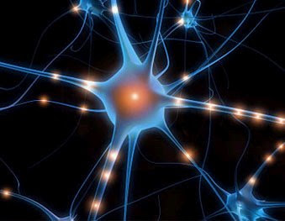
Symptoms
Chorea
Bradykinesia
Dystonia
Difficulties in speech
Depression, apathy, anxiety, irritability
Slowed thinking, impaired concentration, organization, planning, and decision in response to questions
Problems with short term memory, reduced the ability to assimilate new information and solve problems
Notes:
Some of them are..

Slide 22
Diagnosis
Neurological and psychological examination;
Detailed family history;
Genetic testing – to confirm.
Notes:
You can only arrive at a clinical diagnosis of HD through a thorough examination, which usually binds a neurological and psychological examination and a detailed family history. Similarly, genetic testing can be used to help confirm or refute the diagnosis of HD.
The confirmation is made by analysing the gene through PCR (which allows to detect genes with 115 CAG repeats).

Slide 23
Treatment
There is no cure for this disease;
Some symptoms may be minimized through medicines.
Notes:
Huntington's disease is a disease that develops gradually and unfortunately has no cure. However, some symptoms can be minimized through medicines.

Slide 24
A possible therapy for HD is gene silencing.
Most people who suffer from HD are heterozygous.
Normal copy of the gene
Defective copy of the gene
Silencing
Notes:
A possible therapy for HD is gene silencing, through the inhibition of the RNA translation into the mutated htt protein.
Most people affected by HD are heterozygous. They carry a normal copy of the gene (inherited from / the father / mother unaffected / a) and a defective copy of the gene (inherited from / the father / mother affected / a). By silencing the mutated gene, the normal one can be transcribed and the resulting protein will be functional.
Another possible treatment would be the induction of autophagy (with the proteins necessary to the formation of the autophagic complex), in order to decrease the protein aggregates.

Slide 25
Induction of autophagy
Protein aggregates
Improvement of cell function

Slide 26
References
PIERCE, Benjamin A., - “Genética - Um Enfoque Conceitual”, Guanabara Koogan, 2003, PP. 460-461
STRACHAN, Tom; READ, Andrew – “Human Molecular Genetics”, GS – Garland Science, 4th Ed., 2010, PP. 74-75, 424, 512
JORDE, Lynn; CARES, John; CAREY; BAMSAD, Michael – “Medical Genetics”, Mosby Elsevie, 4th Ed., PP. 92-99
LEWIS, Ricki – “Genética Humana, Conceitos e Aplicações”, Guanabara Koogan, 5th Ed., PP. 218-221
http://learn.genetics.utah.edu/content/disorders/whataregd/ (Consultado a 01-03-13)
http://www.indkc.org/neurodegenerative.html (Consultado a 01-03-13)
http://www.news-medical.net/health/Huntingtons-Disease-Genetics-(Portuguese).aspx (Consultado a 02-03-13)
http://medicosdeportugal.saude.sapo.pt/utentes/doencas_neurologicas/dossier_doenca_de_huntington (Consultado a 02-03-13)
http://www.ninds.nih.gov/disorders/huntington/detail_huntington.htm (Consultado a 03-03-13)
http://www.huntington-portugal.com/hdbuzz?hdbuzz=100 (Consultado a 03-03-13)
http://www.youtube.com/watch?v=UIsOCPVAV4Y&feature=player_embedded (Consultado a 28-02-13)
http://physrev.physiology.org/content/90/3/905.full (Consultado a 28-02-13)
http://www.ncbi.nlm.nih.gov/pmc/articles/PMC1299150/ (Consultado a 02-03-13)

