Slide 1


Faculdade de Medicina da Universidade de Coimbra
Biologia Celular e Molecular II
2012/2013
Cellular and Molecular Mechanisms in Phenylketonuria
Work done by:
Cátia Ferreira (T5)
Isa Costa (T6)
Jéssica Vasconcelos (T5)
Sara Ferreira (T6)

Slide 2
Index
Introduction to the disease;
Phenylalanine metabolism and consequences that result of the change of this metabolism;
Symptoms;
Diagnosis;
Treatment;
Maternal PKU.

Slide 3
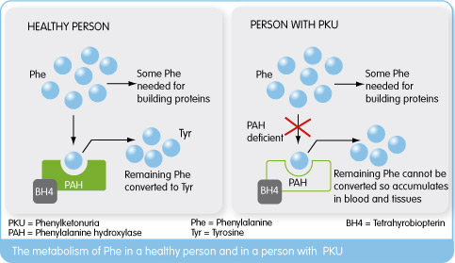
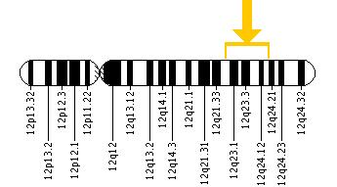
Phenylketonuria
Interesting fact: Norwegian doctor Asbjørn Følling discovered PKU in 1934.
The most common disorder of amino acid metabolism.
Autosomal recessive disorder.
MUTATION
Phenylalanine hydroxylase (PAH) gene
Gene that codifies dihydrobiopterin reductase
PAH gene (12q22-q24.1)
Chromosome 12

Slide 4
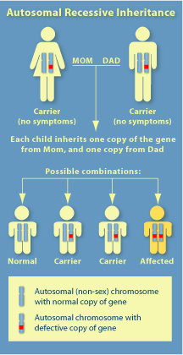
Phenylketonuria
Autosomal recessive disorder.
PHENYLKETONURICS
Homozygous recessive
Compound heterozygous
Presents two equal mutant alleles at a particular gene locus, one on each chromosome of a pair.
Presents two different mutant alleles at a particular gene locus, one on each chromosome of a pair.
Contributes to the biochemistry and clinical heterogeneity of the disease.

Slide 5
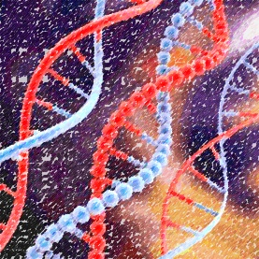
Phenylketonuria
Genetic causes of PKU:
  Deletion of regions of the gene;
  Insertion of additional bases;
  Missense mutations;
  Defect in the splicing;
  Nonsense mutations.
  More than 500 mutations have been identified in the gene PAH.
Some mutations causes the complete destruction of the function of the enzyme, while others are associated with a residual activity of the enzyme.
  In Portugal the prevalence of Phenylketonuria is of 1/12.500 newborns.

Slide 6
Phenylketonuria
Types of PKU/HPA:
 | Enzymatic activity | Blood phenylalanine levels | Treatment
Mild HPA (non PKU) | > 3% | 2-10 mg/dL | No
Mild PKU | 1-3% | 10-20 mg/dL | Yes
Classic PKU | < 1% | > 20 mg/dL | Yes
Exception: Women with mild hyperphenylalaninemia who want to get pregnant.

Slide 7
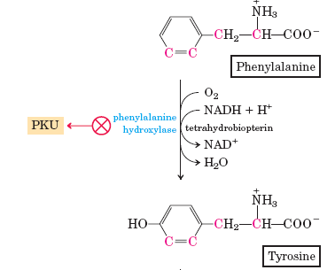
Phenylalanine Metabolism
Approximately 75% of phenylalanine is hydroxylated to tyrosine by the action of phenylalanine hydroxylase.
The presence of the cofactor tetrahydrobiopterin (BH4), oxygen and NADH is necessary for this hydroxylation.
Tyrosine is used in the synthesis of catecholamines, melanin, proteins and fumarate.

Slide 8
Phenylketonuria
Mutations in PAH gene originate the absence or deficit of phenylalanine hydroxylase.
The hydroxylation of phenylalanine to tyrosine is blocked.
The plasma concentration of phenylalanine increases, activating alternative degradation pathways.

Slide 9
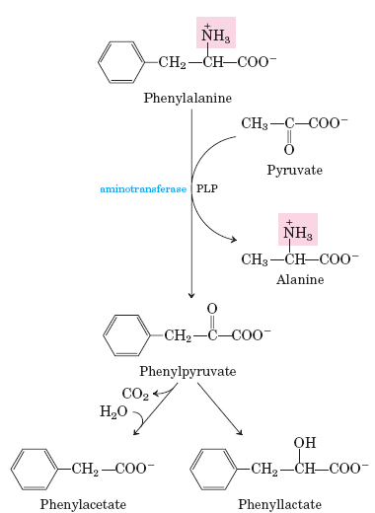
Alternative Metabolic Pathway
Phenylalanine undergoes transamination by the action of a transaminase and is converted to phenylpyruvate.
The decarboxylation of phenylpyruvate gives rise to phenylacetate.
The reduction of phenylpyruvate leads to the production of phenylactate.

Slide 10
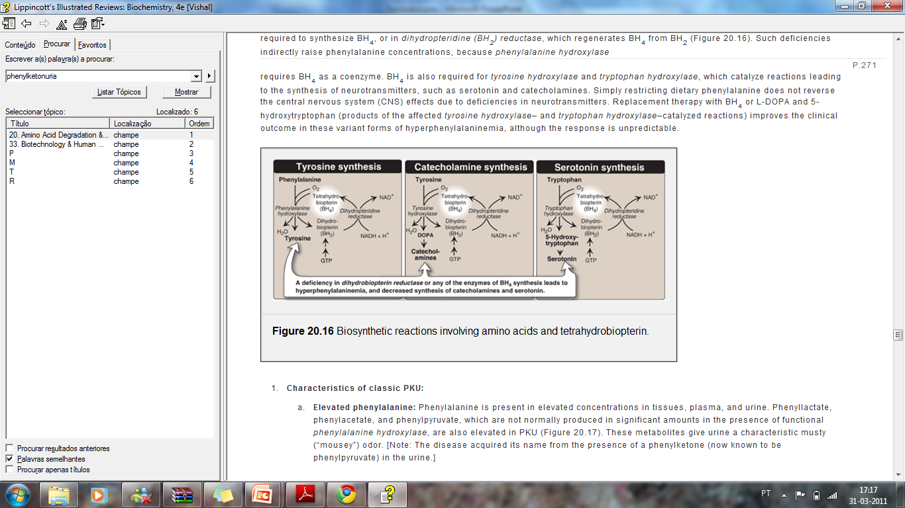
Phenylketonuria (Phenocopy)
In 2 to 3% of the cases, disorders in the metabolism of BH4 can also lead to Phenylketonuria. These disorders are related to a deficiency in dihydrobiopterin reductase, which is essential in the regeneration of BH4 from BH2.
Deficits or the absence of BH4 compromises: the hydroxylation of phenylalanine to tyrosine; hydroxylation of tyrosine to L-dopa and the hydroxylation of tryptophan to 5-hydroxy-tryptophan.
With the synthesis of neurotransmitters compromised there is a progressive deterioration of neurological function.

Slide 11
Consequences
The high concentration of phenylalanine in the blood plasma will result in competition with other amino acids at this transportation across the blood-brain barrier, resulting in a deficit of some amino acids in the brain.
The excess of phenylalanine inhibits hydroxylation of tyrosine by tyrosinase, which is the first step of melanin formation, resulting in hypopigmentation of hair and skin.
The high concentration of phenylalanine may also inhibit the enzymes tyrosine hydroxylase and tryptophan hydroxylase, leading to the decrease of the production of neurotransmitters (as dopamine and serotonin).

Slide 12
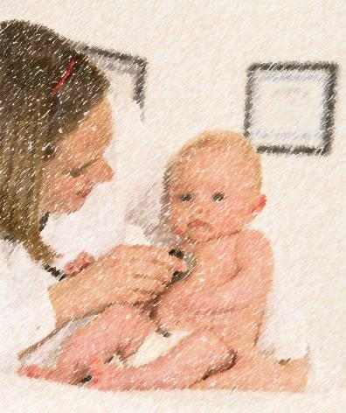
Symptoms
Mental retardation and developmental delay;
Microcephaly;
Hypopigmentation;
  Light colored skin, hair and eyes;
Seizures;
Dermatitis;
Eczematous rash;
Characteristic odor in the urine, skin and hair;
Behavioral disorders.

Slide 13
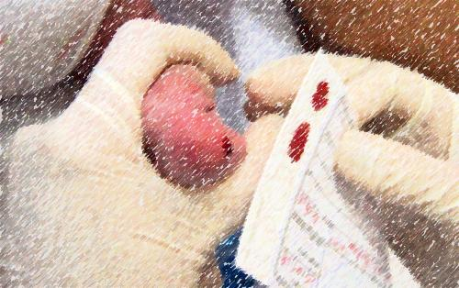
Diagnosis
Guthrie Test - Bacterial Inhibition Assay (BIA)
First efficient test developed by Robert Guthrie. The test was based on Bacillus subtilis, which requires Phe for growth.
The Guthrie test is a semiquantitative assay designed to detect elevated blood levels of the amino acid phenylalanine, using the ability of phenylalanine to facilitate bacterial growth in a culture medium with an inhibitor.

Slide 14
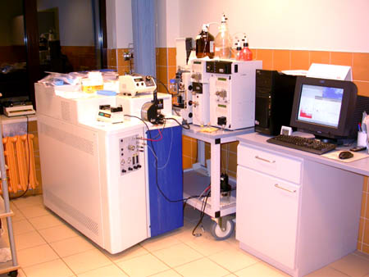
Diagnosis
Tandem Mass-Spectrometry
Developed as a fast method for achieving reliable and quantitative determination of concentrations of amino acids in small volumes of blood or plasma. Measuring levels of both Phe and Tyr and providing the Phe/Tyr ratio.

Slide 15
Diagnosis
Fluorometric Analysis
Fluorometric assays, that can detect differences in blood Phe levels as low as 6 mmol/L (0.1 mg/dl), are alternative forms of testing that also offer excellent sensitivity.
Fluorometric assays, provide more precise measurements of blood Phe levels than the Guthrie test and lower false negative rates as well.
BH4 (sapropterin dihydrochloride) Loading Test
About 2% of all Phe level elevations detected by the newborn screening are due to disorders in BH4 metabolism, highlighting the importance of always considering the differential diagnosis for every even slightly elevated blood Phe level.
Differential Diagnosis
Detection of BH4-responsive PKU patients is important because some patients benefit from oral administration of BH4 in that their blood Phe level decreases or even normalizes under pharmacological therapy with BH4.

Slide 16
Diagnosis
Genetic Tests
Genetic counseling
- Determination of holders
- Prenatal diagnosis
Genetic Techniques
Restriction enzyme digestion
Detection of mutations by sequencing
Multiplex ligation probe amplification
Southern blotting

Slide 17
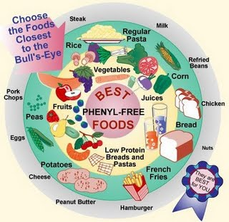
Treatment
Restriction of Dietary Phenylalanine
Restricts the intake of Phe
Control the Phe and Tyr concentration in the blood.
Blood Phe level
120 to 360 mmol/L
(National Institutes of Health, 2001)
Phe-free medical foods.

Slide 18
Treatment
Restriction of Dietary Phenylalanine
Monitoring the ingestion of Tyr and total amino acids.
Avoid long periods of low blood Phe concentration.
Measurement of blood phenylalanine levels:
For the first year of life
On a weekly basis
Until age 13
On a biweekly basis
Thereafter
On a monthly basis

Slide 19
Treatment
Glycomacropeptide
Protein derived from cheese whey that is naturally free of Phe.
It provides amino acids that are necessary for health and reduces blood and brain Phe levels.
Supplementation With BH4
There are no data to directly establish the potential effects of BH4 on longer-term clinically important outcomes.

Slide 20
Treatment
Large Neutral Amino Acids (LNAA) Transporters
At the blood-brain barrier, Phe shares a transporter with other LNAA
LNAA supplementation has reduced brain Phe concentration by competition at this transporter.
These supplements will not replace the Phe-restricted diet!
Larger clinical trials are needed before conclusions on the effectiveness of these treatments can be made.

Slide 21
Treatment
Enzyme Replacement Therapy
Phenylalanine ammonia lyase (PAL) is a plant-derived enzyme that also degrades Phe (without synthesizing Tyr) and does not require a cofactor.
Problems…
The oral route is complicated by proteolytic degradation.
Injected PAL is complicated by increased immunogenicity.
Clinical trials are currently underway!

Slide 22
Treatment
Gene Therapy
In a study with mice in vivo
Infusion of recombinant adenoviral vectors to the liver resulted in a significant increase in PAH activity.
But…
The effect did not persist;
Repeated administrations did not generate the original results due to neutralizing antibodies against the viral vectors;
No phenotypic changes were observed and the mice remained hypopigmented.

Slide 23
Maternal PKU
If the woman has high plasma Phe concentrations, her intrauterine environment will be hostile to a developing fetus.
PKU during pregnancy exposes the developing fetus to elevated blood Phe concentrations:
Low birth weight
Microcephaly
Facial dysmorphism
Developmental retardation
Congenital heart disease

Slide 24
Maternal PKU
If women with PAH deficiency are planning a pregnancy:
They should start a Phe-restricted diet prior to conception, ideally over several months.
After conception:
They should be offered continuous nutritional guidance;
Weekly or biweekly measurement of plasma Phe concentration;
They should have an adequate energy intake with the proper proportion of protein, fat, and carbohydrates.

Slide 25
Bibliography
ACTA PEDIÁTRICA PORTUGUESA - Consenso para o tratamento nutricional de fenilcetonúria. Sociedade Portuguesa de Doenças Metabólicas, 2007.
BERG, Jeremy M., TYMOCZKO, John L., STRYER, Lubert – Biochemistry. 6th edition, W.H.Freeman & Co, 2008.
FEILLET, F. et al. - Challenges and Pitfalls in the Management of Phenylketonuria. Pediatrics, 2010.
LINDEGREN, M.L. et al. - A Systematic Review of BH4 (Sapropterin) for the Adjuvant Treatment of Phenylketonuria. JIMD Reports – Case and Research Reports, 2012.
NELSON, David L., COX, Michael M. – Lehninger Principles of Biochemistry. 4th edition, New York: W. F. Freeman and Company, 2005.
REGATEIRO, Fernando J. – Manual de genética médica. 1ª edição, 2007.
BLAU, N. et al. - Diagnosis, classification, and genetics of phenylketonuria and tetrahydrobiopterin (BH4) deficiencies. Mol Genet Metab, 2011;104.
Williams, R.A. et al. - Phenylketonuria: an inborn error of phenylalanine metabolism. Clin Biochem Rev. 2008 Feb;29(1):31-41.

